Slide 1
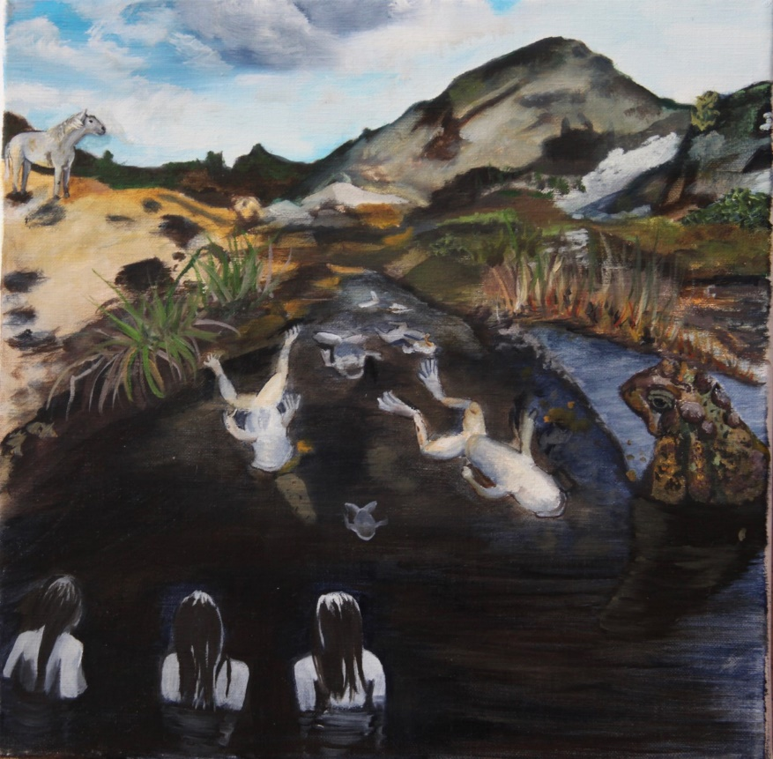
Discussion Questions
Look back at the graph on the African clawed frog activity sheet you completed earlier.
Based on the video you just watched, were your predictions about changes in biodiversity with the rise of Chytrid accurate?

Slide 2

Discussion Questions
What did scientists suggest was the best way to control the Chytrid outbreak?
Think back to the 3Rs: Which “R” do you think this management plan best represents?

Slide 3
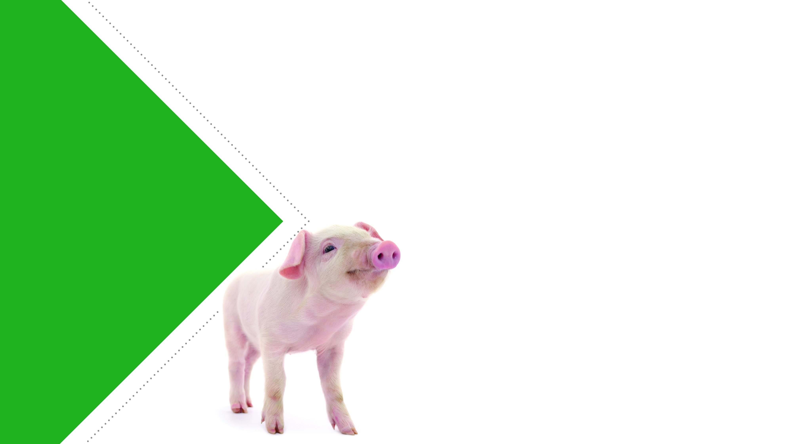
The 3Rs Reviewed
Replacement is the substitution of animals that can feel distress with models incapable of feeling anything.
Reduction is a decrease in the number of animals in an experiment that can experience distress.
Refinement is the reduction or elimination of distress that laboratory animals experience during research.

Slide 4
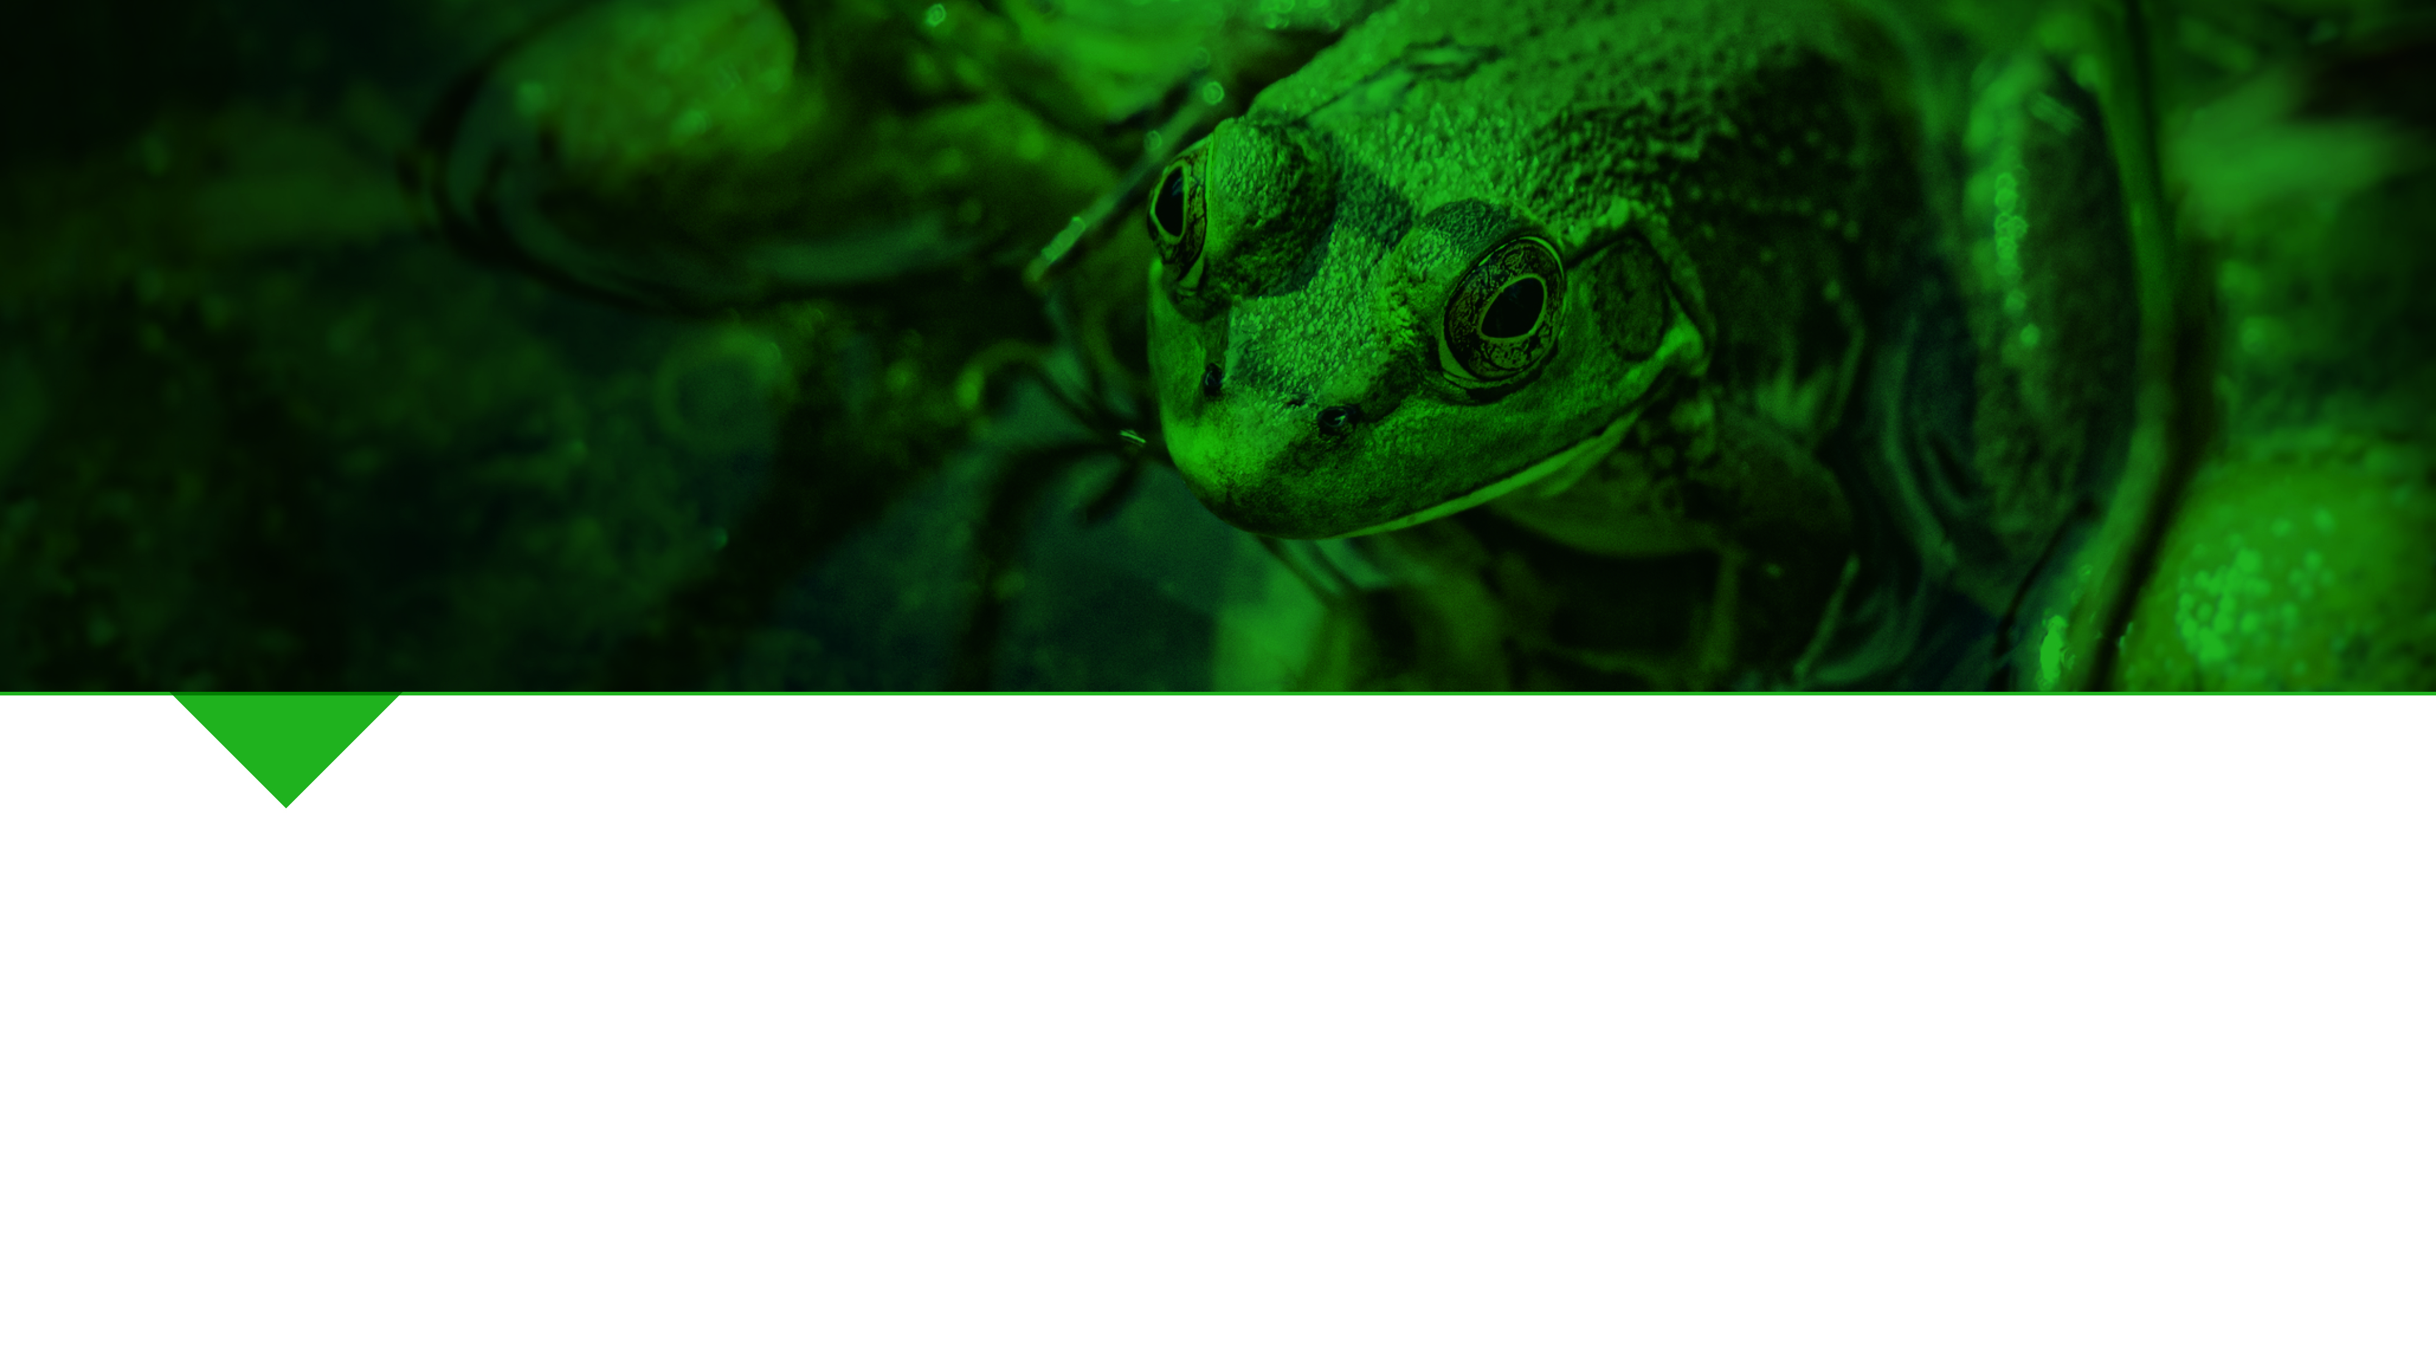
Reduction
By reducing the number of amphibians trafficked worldwide, scientists hope to curtail the spread of Chytrid to wild populations that have not yet been affected.
Can you think of how any of the other Rs might be implemented to stop the spread of Chytrid?

Slide 5
Replacement
By replacing the use of African clawed frogs and other carriers of Batrachochytrium dendrobatidis with non-animal testing methods, scientists can ensure that no more individuals will escape into the wild and establish invasive populations.

