Slide 1
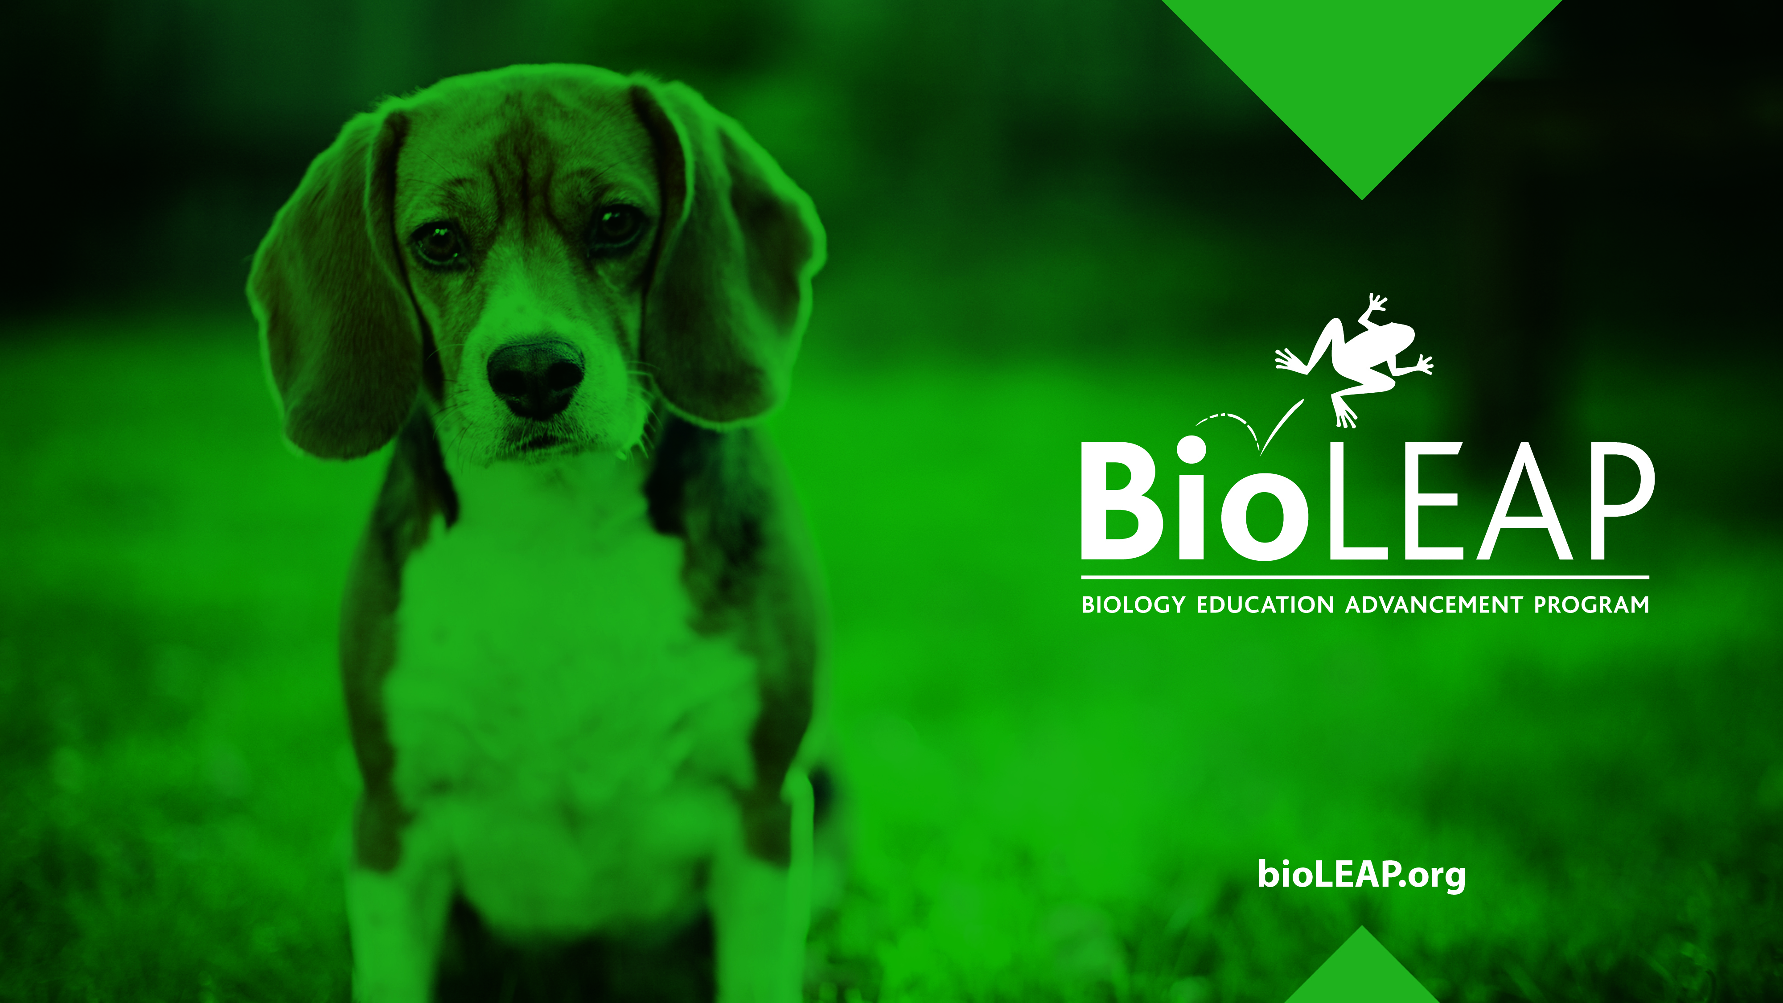
Considerations for
Well-Designed
Animal Experiments

Slide 2
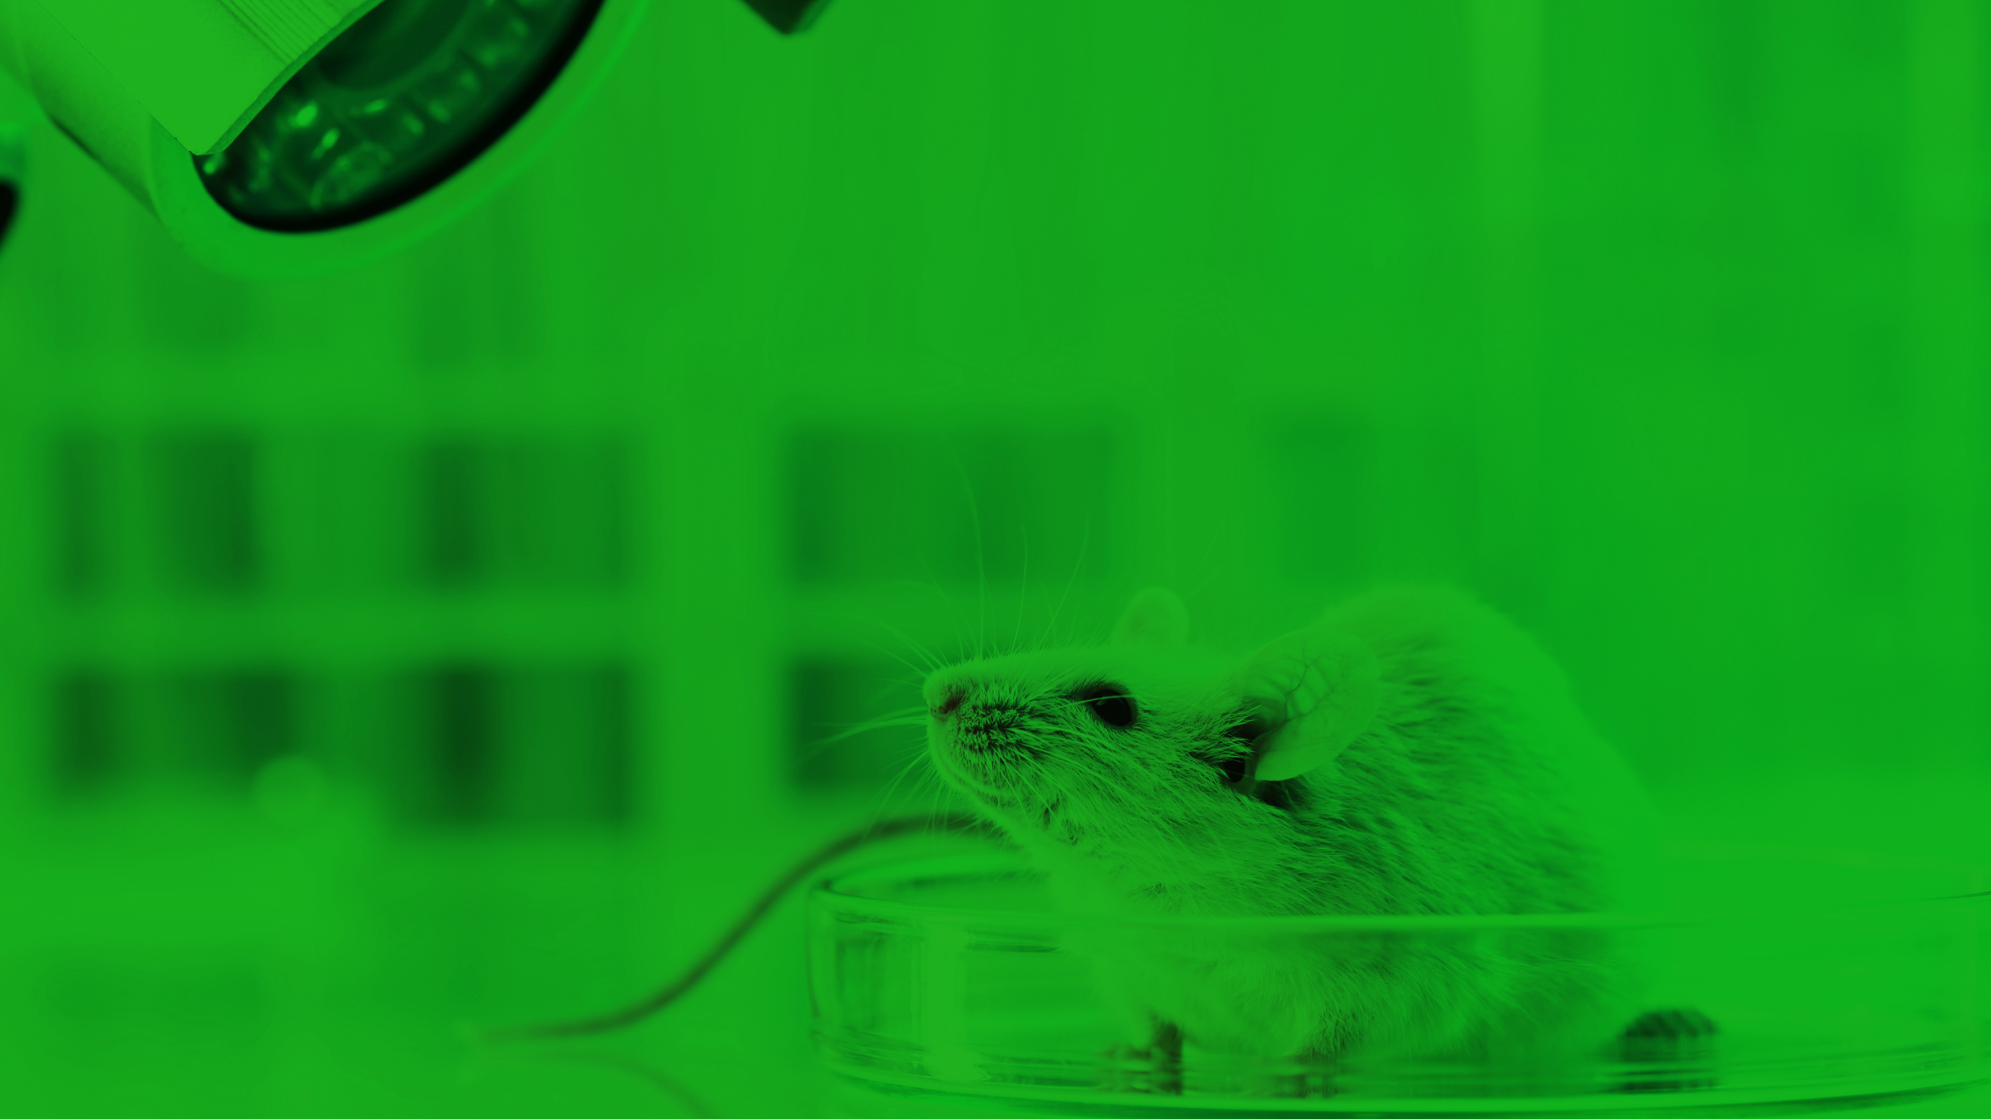
Scientific research is only of value when the results can be replicated, and researchers have confidence that the data they have generated are reliable.
Reproducibility issues are a problem across all scientific disciplines, but they are particularly prevalent in animal research.

Slide 3
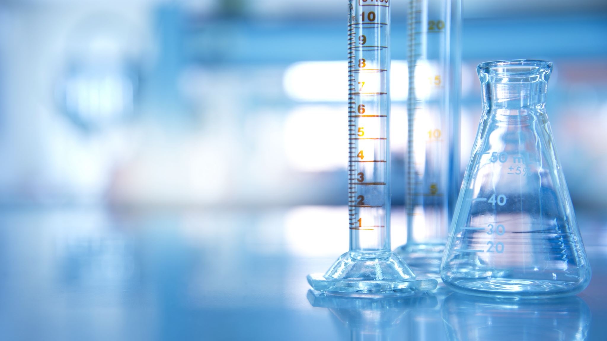
Francis Collins, MD, PhD, former director of the National Institutes of Health, said:
“Preclinical research, especially work that uses animal models, seems to be the area that is currently most susceptible to reproducibility issues.”
Collins FS and Talbek LA. 2014. “NIH plans to enhance reproducibility.” Nature. 505(7485): 612–613.

Slide 4
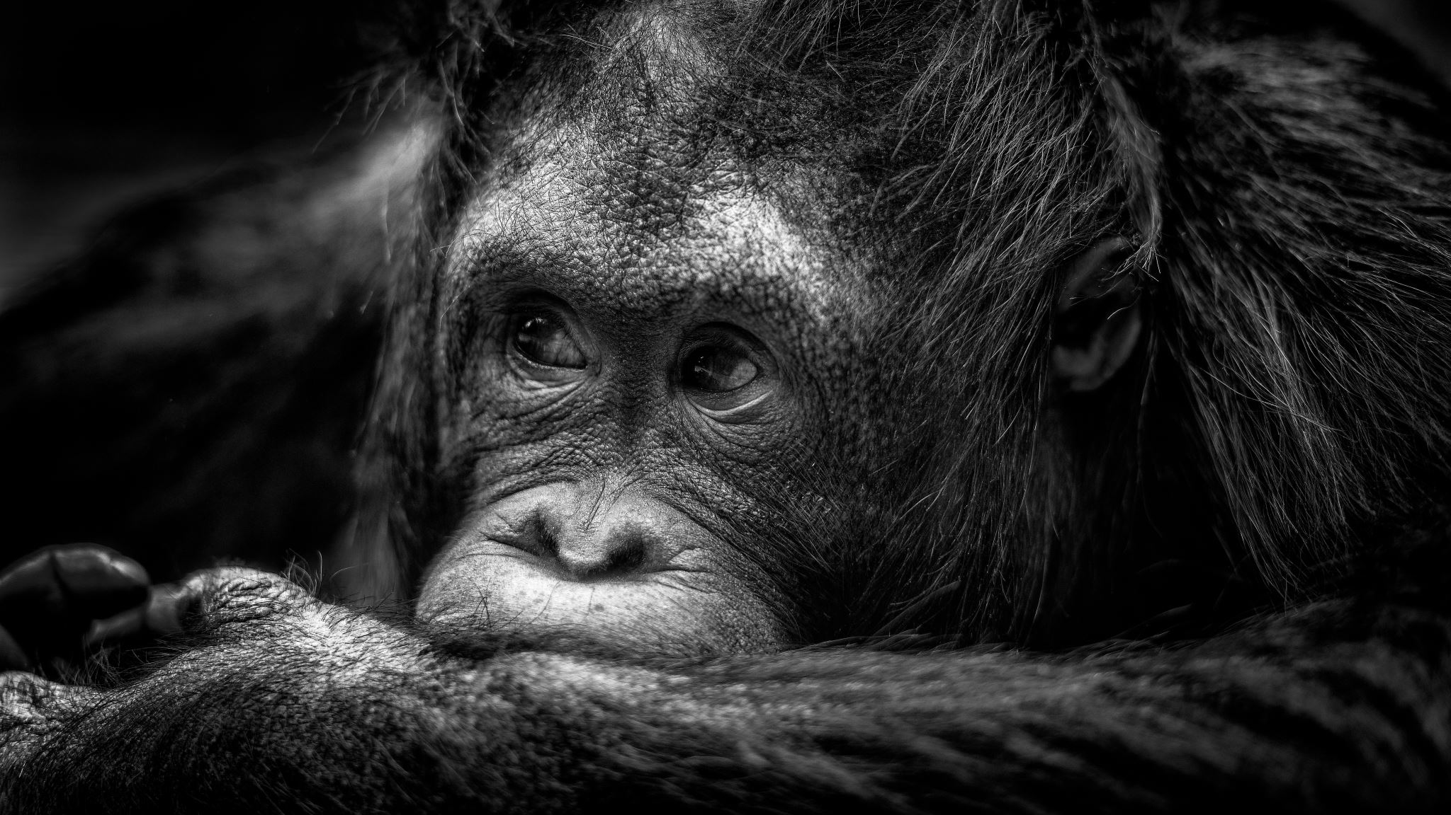
It has been estimated that 51-89% of preclinical studies, a large portion of which involve animal research, are not reproducible.
Freedman LP, Cockburn IM, Simcoe TS. 2015. “The Economics of Reproducibility in Preclinical Research.” PLoS Biol 13(6): e1002165. doi:10.1371/journal.pbio.1002165

Slide 5
How can the 3Rs be used to address the reproducibility crisis in research involving animals?

Slide 6
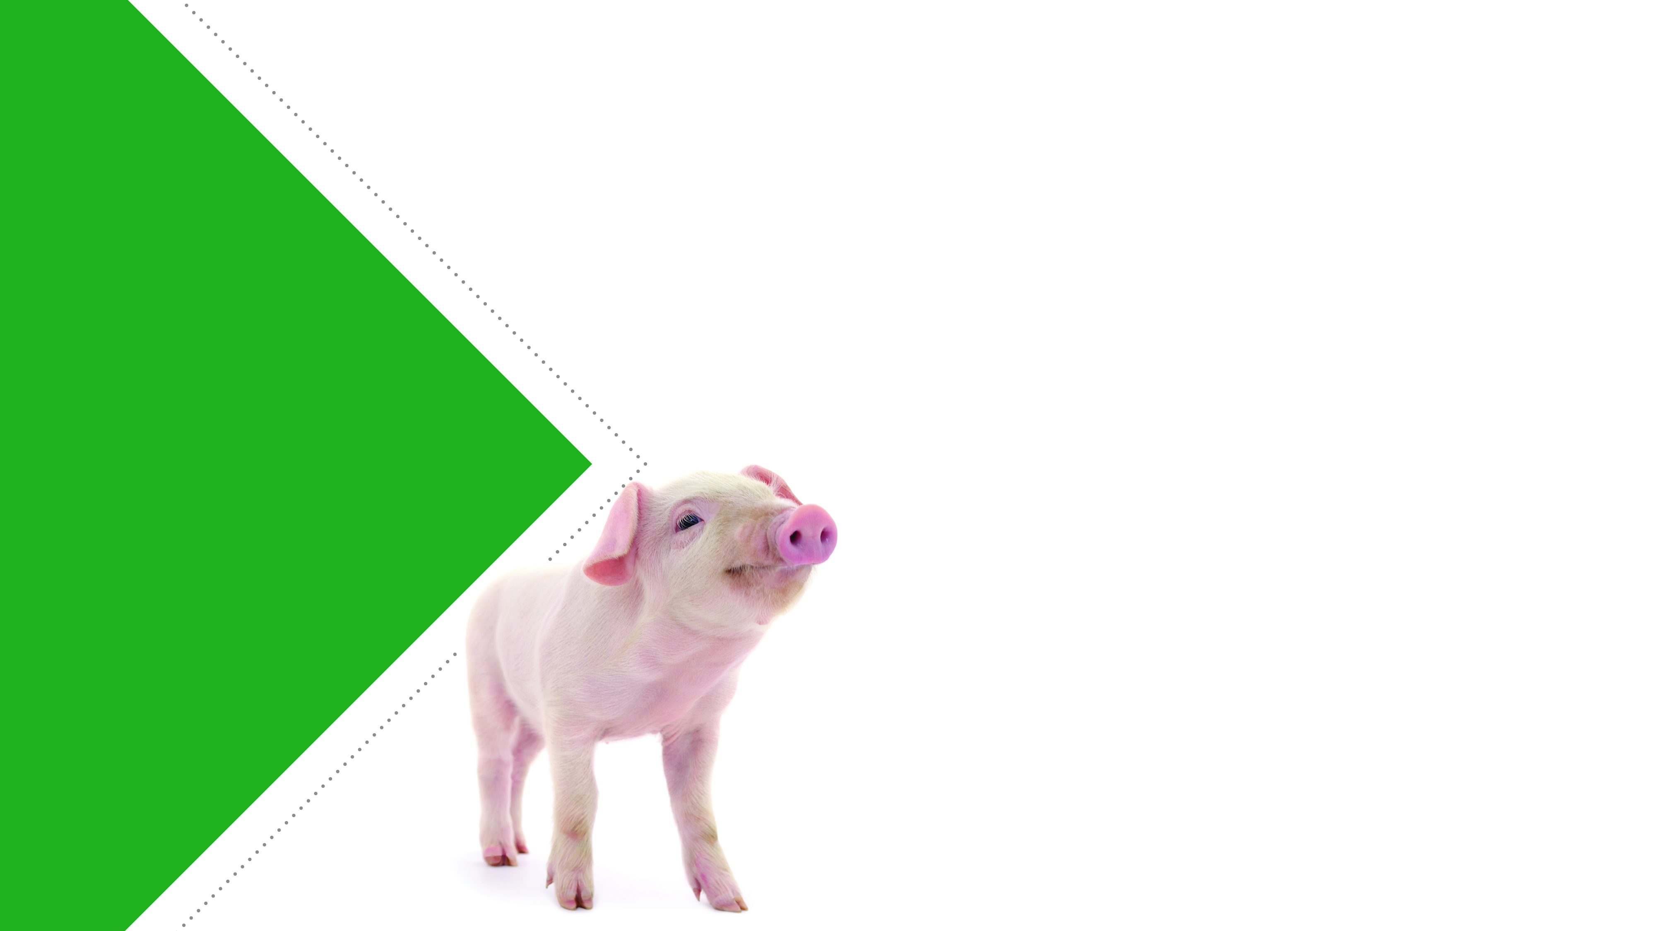
Replace
The animal model has long been considered the gold standard in research, but the failure to reproduce most animal studies tells a different story.
There is a need to improve the reproducibility of preclinical research by developing and using more human relevant models.

Slide 7
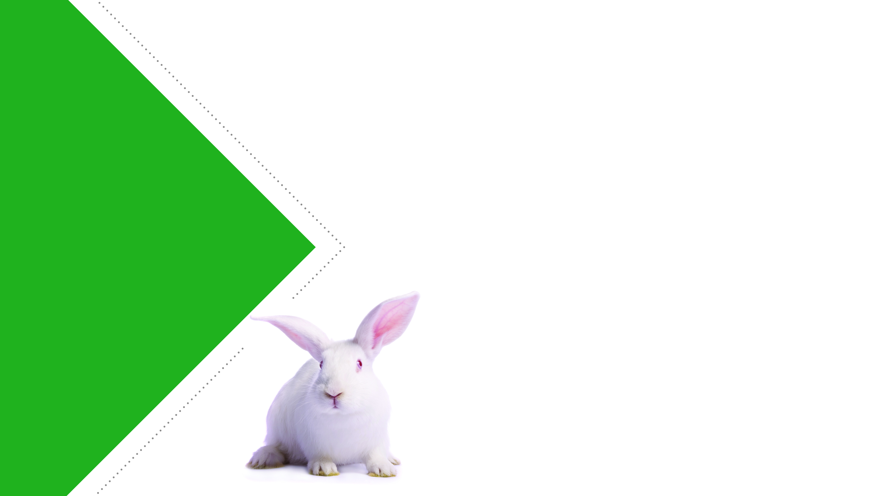
Reduce
Sample size calculations
  It is important to choose an appropriate number of animals to use in an experiment.
  This information is essential for determining the validity of statistical analyses and the robustness of the experimental results.

Slide 8
Refine
Study results can be altered when lab animals are stressed or in pain.
Animals that are consistently kept in good welfare conditions may make more reliable models, increasing the reproducibility of the studies that they are used for.

Slide 9
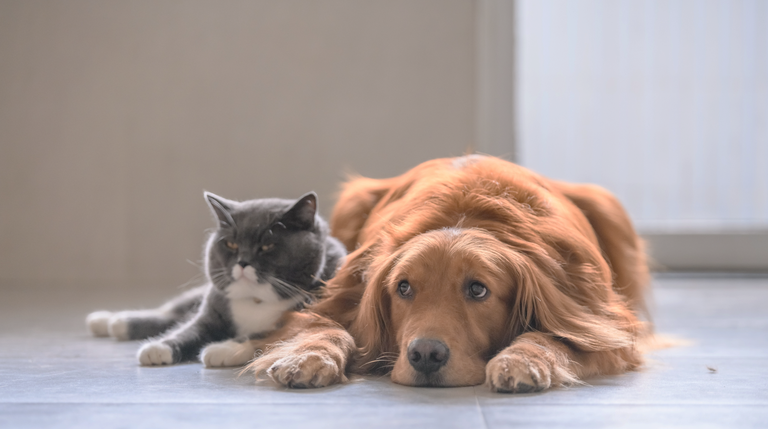
What can be done to improve the quality of research involving animals?

Slide 10
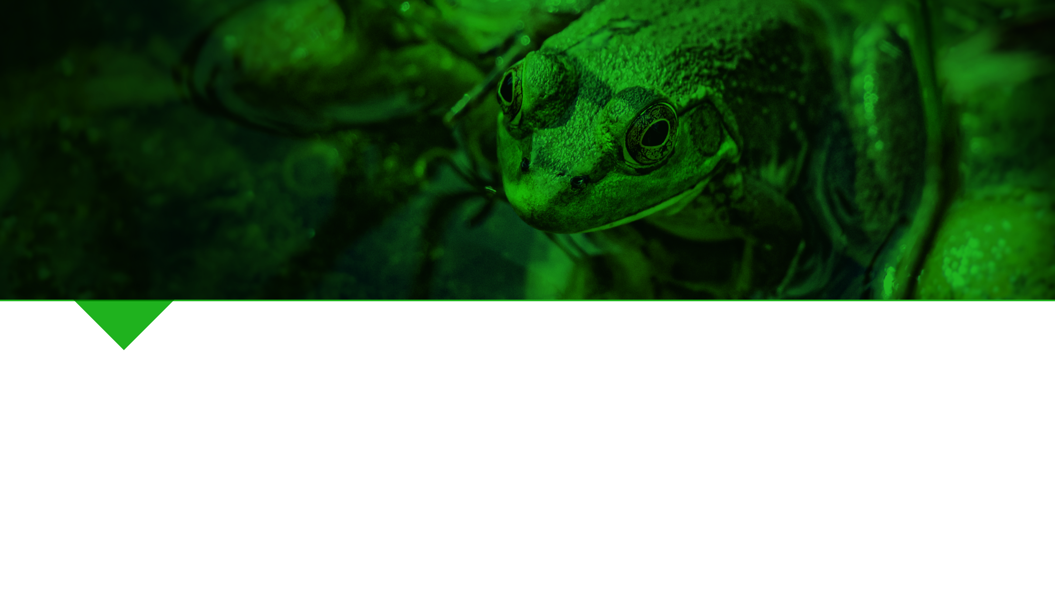
Minimize bias
Scientists often expect a certain outcome in an experiment, and they can unintentionally influence the experiment or how they interpret the data to support their preferred hypothesis.
  Blinding: concealing which groups study subjects belong to from researchers conducting the study
  Randomization: randomly assigning study subjects to different control and experimental treatment groups

Slide 11

Provide sufficient information when publishing data on work involving animals
Many experiments involving animals are not reproducible because important details regarding the methods researchers use in their experiments are not included in scientific publications.
Guidelines have been established to help researchers determine what information is essential to include in published manuscripts.
You will learn more about these guidelines in the activity that follows this presentation.

Slide 12

Food for Thought
Even if efforts are made to make animal experimentation more reproducible, that doesn’t guarantee that results from animal studies can successfully translate to people.
All models, including animal models, have limitations in their ability to effectively translate data to humans.

Slide 13

References
Collins FS and Talbek LA. 2014. “NIH plans to enhance reproducibility.” Nature. 505(7485): 612–613.
Freedman LP, Cockburn IM, Simcoe TS. 2015. “The Economics of Reproducibility in Preclinical Research.” PLoS Biol 13(6): e1002165. doi:10.1371/journal.pbio.1002165
https://arriveguidelines.org/arrive-guidelines

