Slide 1
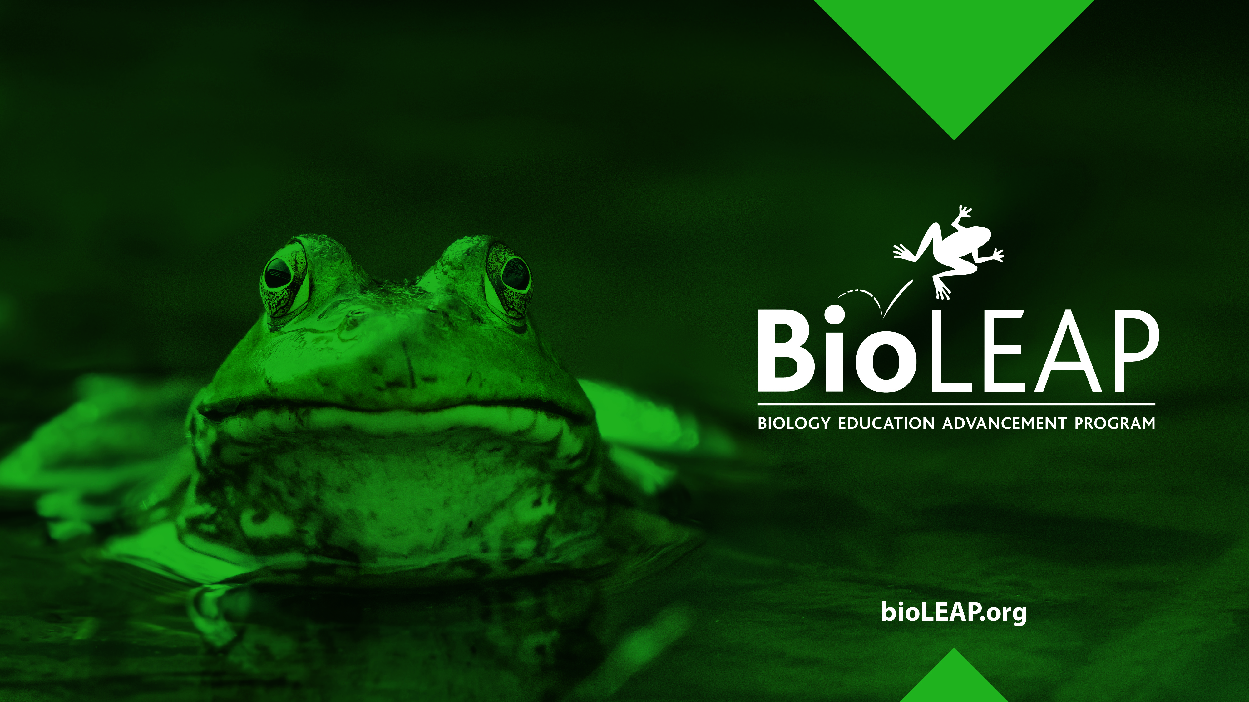
Replacement

Slide 2
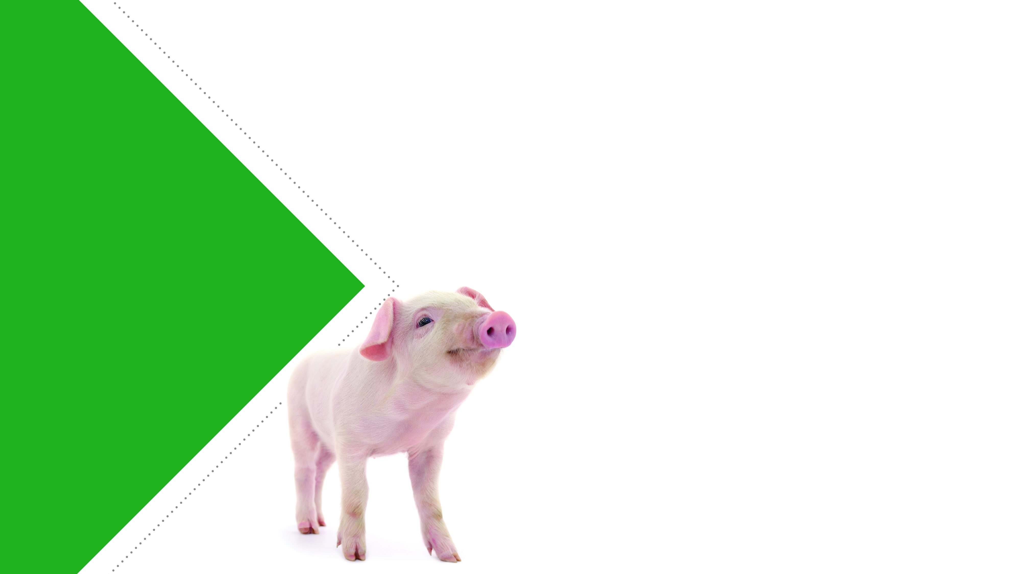
The 3Rs Reviewed
Replacement is the use of methods or approaches that do not involve the use of live animals.
Reduction refers to using fewer animals to achieve the same objective in an experiment.
Refinement refers to efforts made to reduce or eliminate the distress that laboratory animals experience during research.

Slide 3
Replacement
Replacement is the use of non-animal models, such as computer simulations or cell-based models, in place of animals.
Some definitions of replacement include the use of animal species lower on the phylogenetic scale in place of animals higher on the phylogenetic scale.

Slide 4
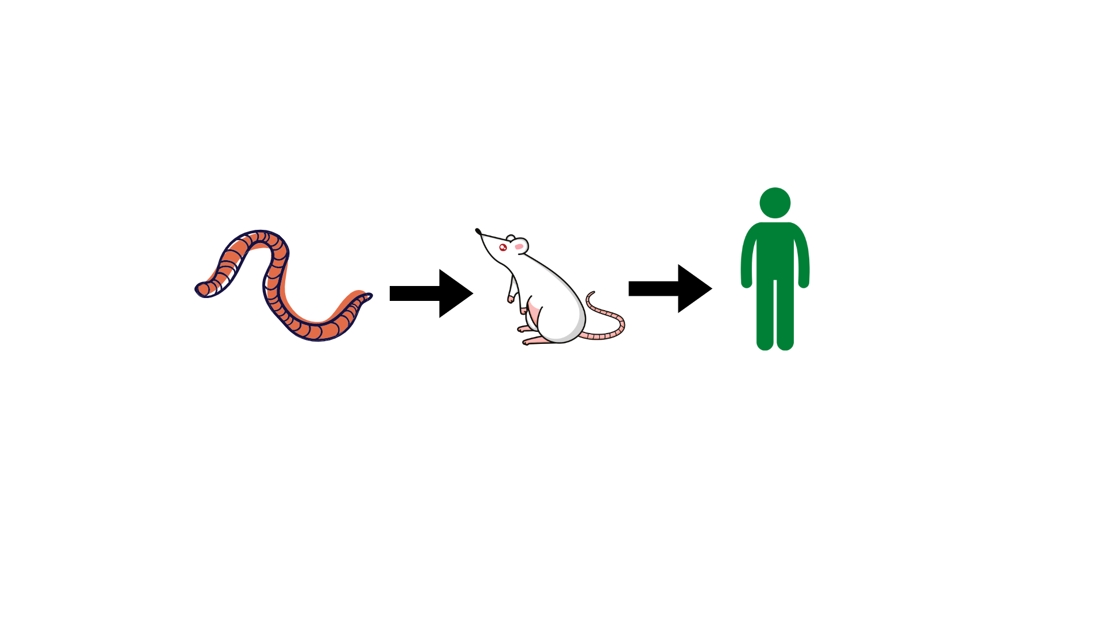
What is the Phylogenetic Scale?
Animal life can be sorted along a scale from very simple organisms to very complex organisms.
  For example: worms mice humans
The assumption is that animals lower on the phylogenetic scale have a lower potential for pain perception than animals higher on the scale.

Slide 5

Replacement
Replacement models:
are often less expensive than animals
require less time for testing than animals
overcome the ethical issues of using animal models
can mimic human biology more closely than animals

Slide 6
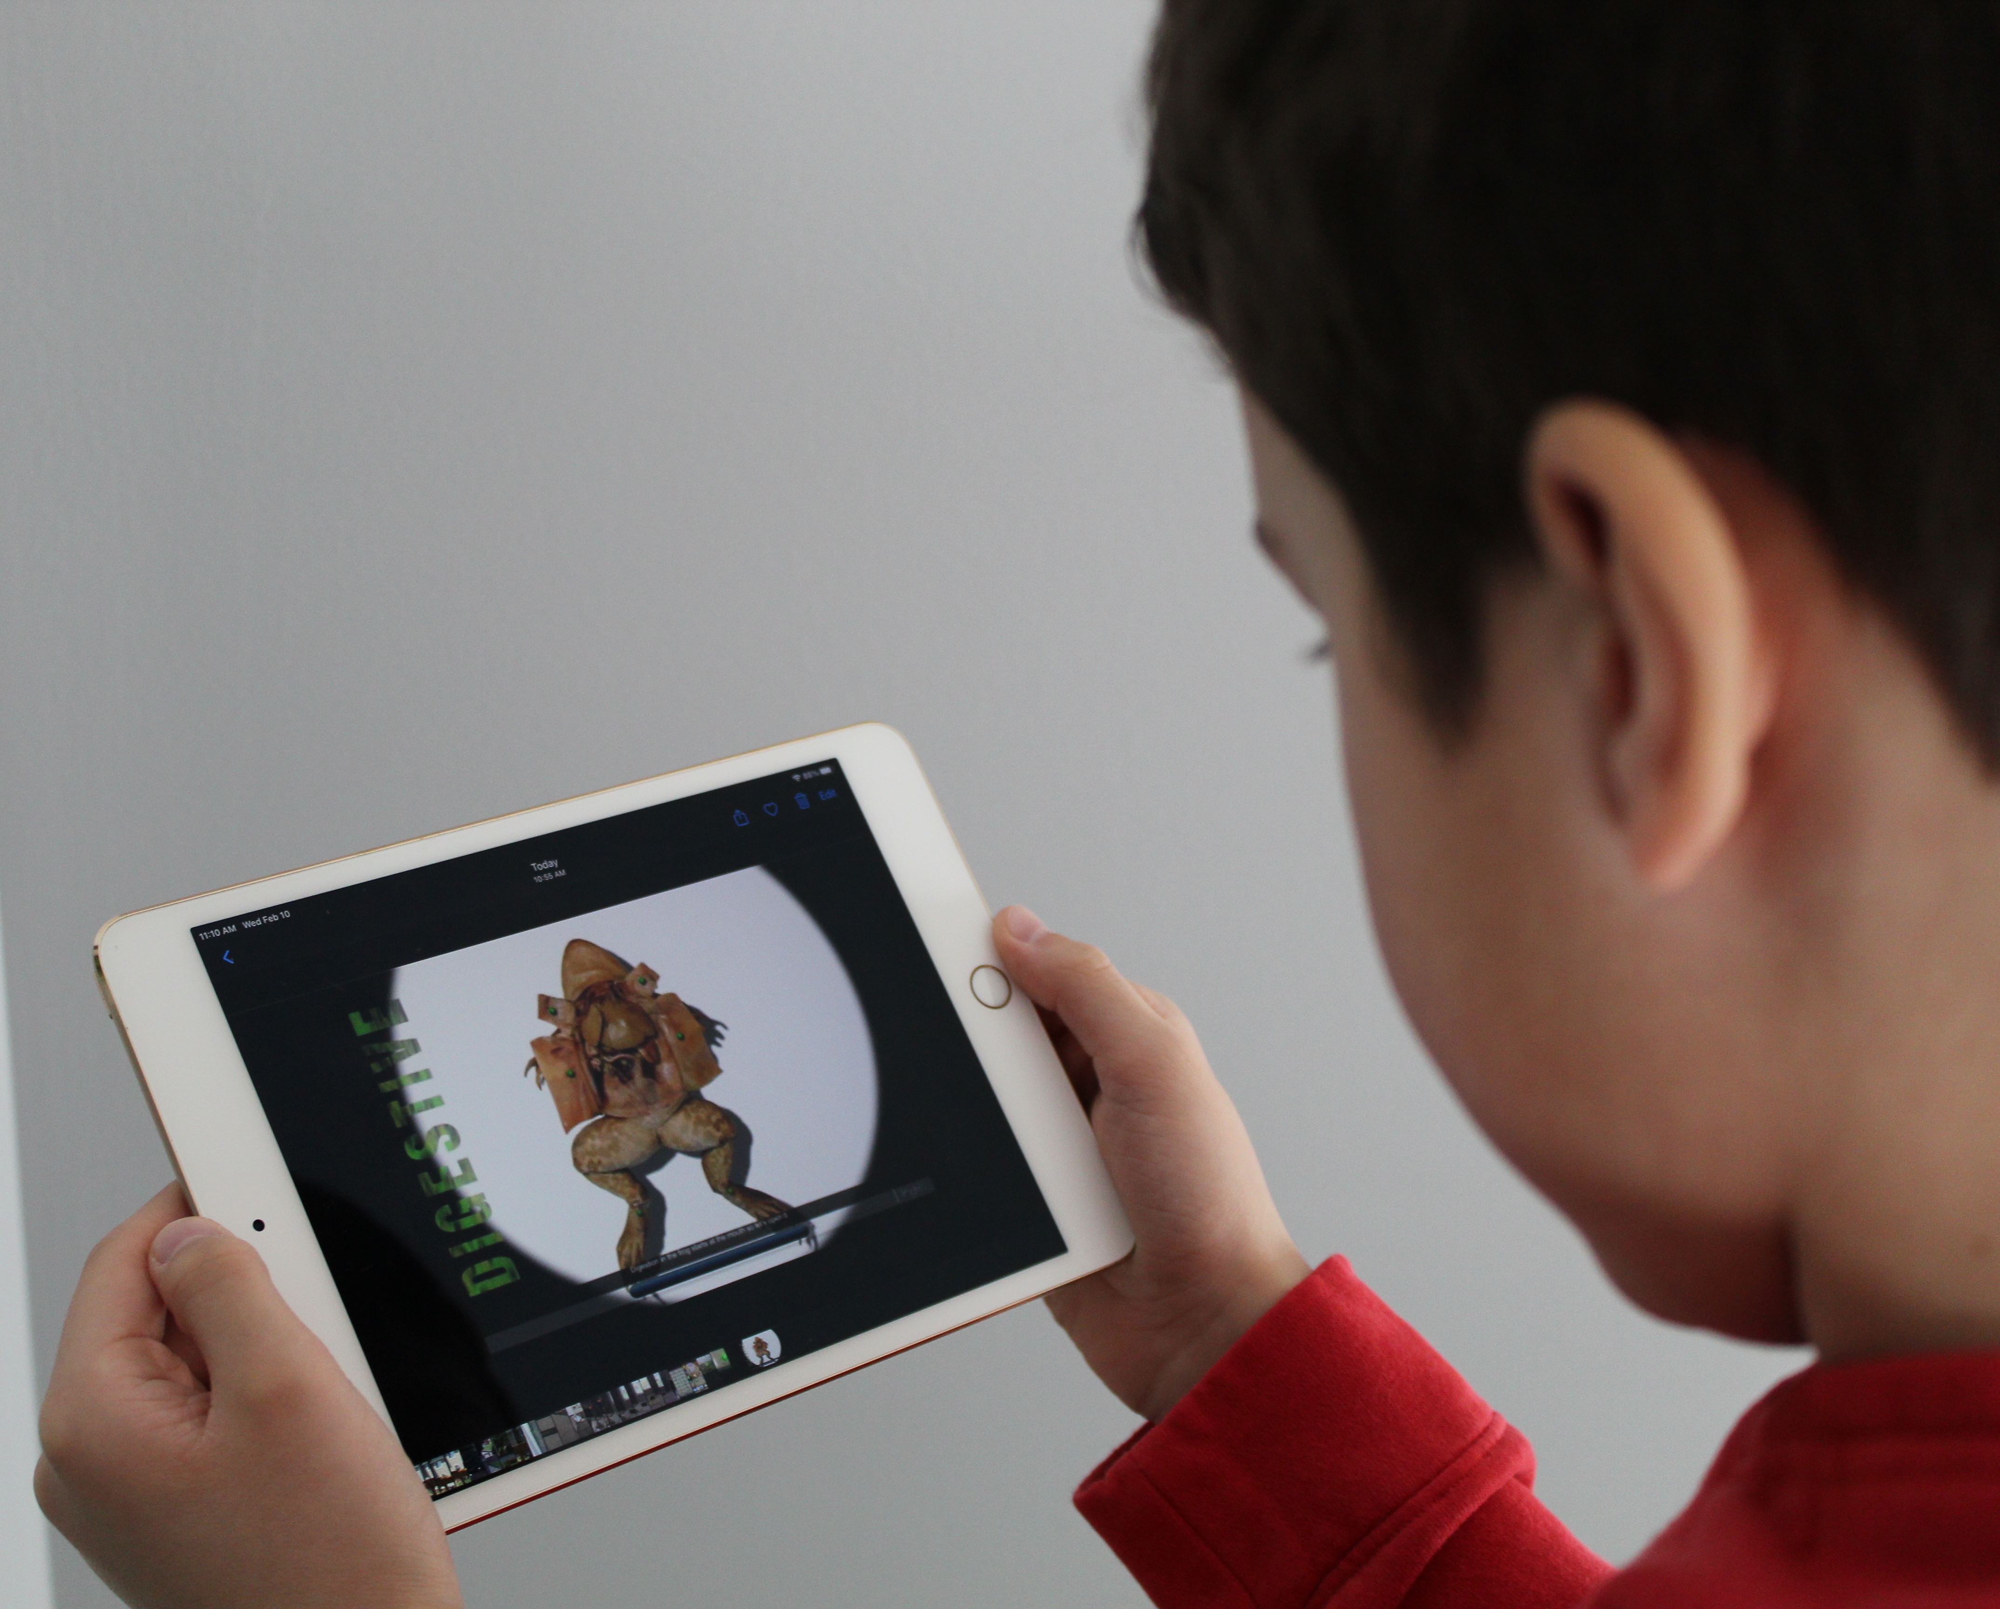
Examples of Replacement Models
Non-animal Teaching Methods
There are many dissection products that can serve as replacements for dissection of animal specimens:
  web-based programs
  apps
  3D models
Studies show that humane dissection tools are as good as, or better, at achieving learning goals compared to traditional dissection with animal specimens (Zemanova & Knight, 2021; Ormandy et al, 2022).

Slide 7
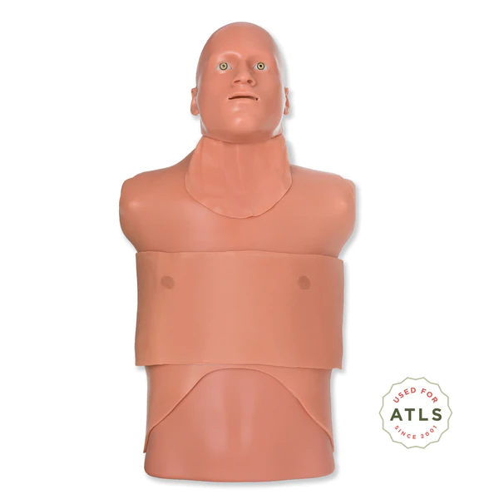
Examples of Replacement Models
Human-Relevant Simulators
Advanced trauma life support courses are offered to physicians to teach them how to safely care for trauma patients.
Physicians learn how to assess a patient’s condition and how to resuscitate and stabilize trauma patients.
While the use of animals, like pigs and goats, were more commonplace in these courses years ago, use of sophisticated simulators, like Simulab’s Trauma Man, have largely replaced animal use in this area.

Slide 8
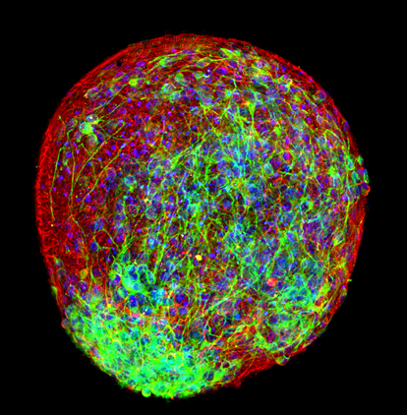
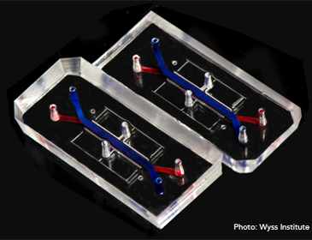
Examples of Replacement Models
Sophisticated Cell-Based Models
Organoids and organs-on-chips can mimic some of the structure and function of real organs.
They can be used as disease models and in toxicology and drug discovery studies.
They have the potential to replace animal models in many areas of research.
Models of many human organs, including the kidney, liver, heart and lung, have already been developed and are in use today.

Slide 9

References
Ormandy, E. et al. (2022). Animal dissection vs. non-animal teaching methods: A systematic review of pedagogical value. American Biology Teacher, Volume 84, No. 7.
Traumaman System. Simulab Corporation. https://simulab.com/collections/traumaman-system
U.S. Department of Health and Human Services. Meet Chip. National Center for Advancing Translational Sciences. https://ncats.nih.gov/tissuechip/chip
Zemanova, M.A. & Knight, A. (2021). The educational efficacy of humane teaching methods: A systematic review of the evidence. Animals, 11(1), 114.

