Slide 1
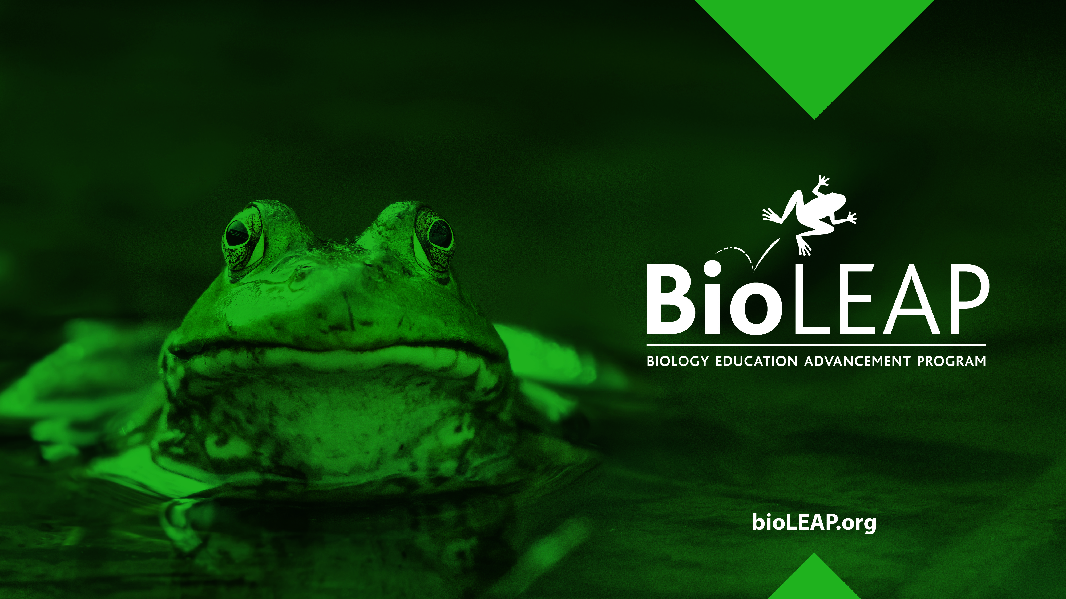
Application of the 3Rs

Slide 2

The 3Rs Principles
The 3Rs (Replacement, Reduction, and Refinement) are a set of guiding principles that help scientists conduct more ethical research using animals.

Slide 3
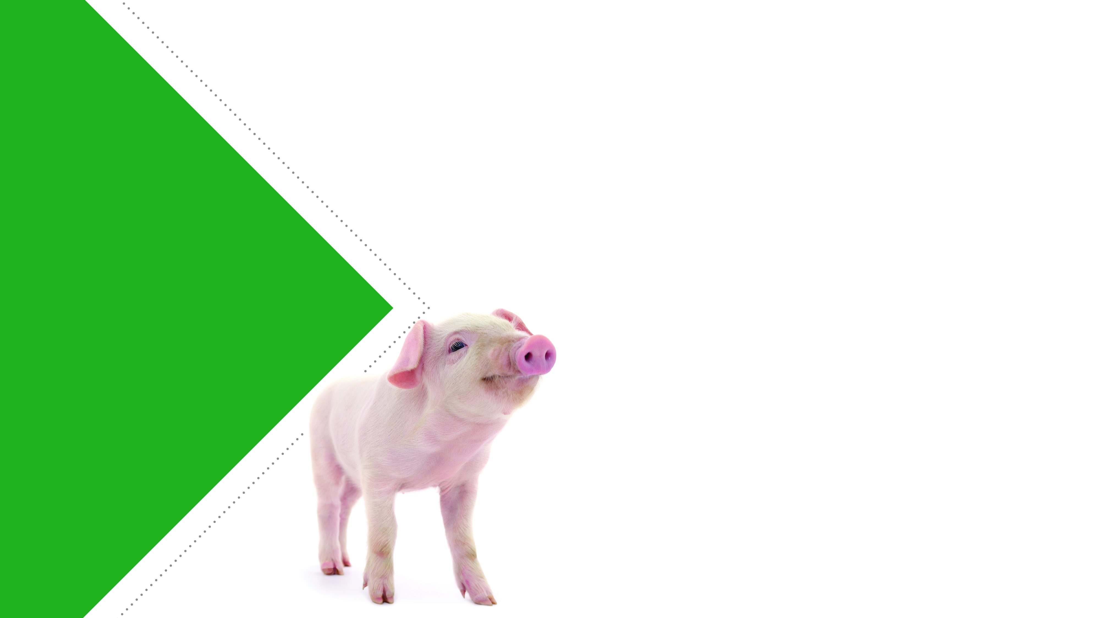
The 3Rs Reviewed
Replacement is the use of methods or approaches that do not involve the use of live animals.
Reduction refers to using fewer animals to achieve the same objective in an experiment.
Refinement refers to efforts made to reduce or eliminate the distress that laboratory animals experience during research.

Slide 4

Application of the 3Rs
How can scientists replace, reduce, or refine the use of animals in laboratory experiments?

Slide 5
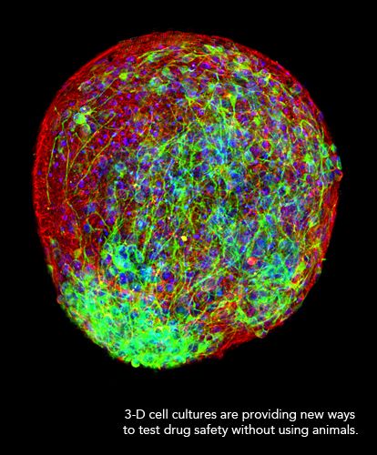
Options for Replacement
In vivo models – refers to living organisms
  Comparative substitution
    For example, using invertebrates like nematodes or fruit flies instead of vertebrates like mice or fish, which have complex welfare needs.
  Ethical human experimentation
In vitro models – refers to models in test tubes or culture dishes, those outside of a living organism
  2-dimensional cell culture in which cells are grown in a single, flat layer
  3-dimensional cell culture (organoids, organ-on-chips) - cells grown in 3D more closely mimic the in vivo architecture of tissues and organs
In silico models – refers to research or tests done with computer models

Slide 6
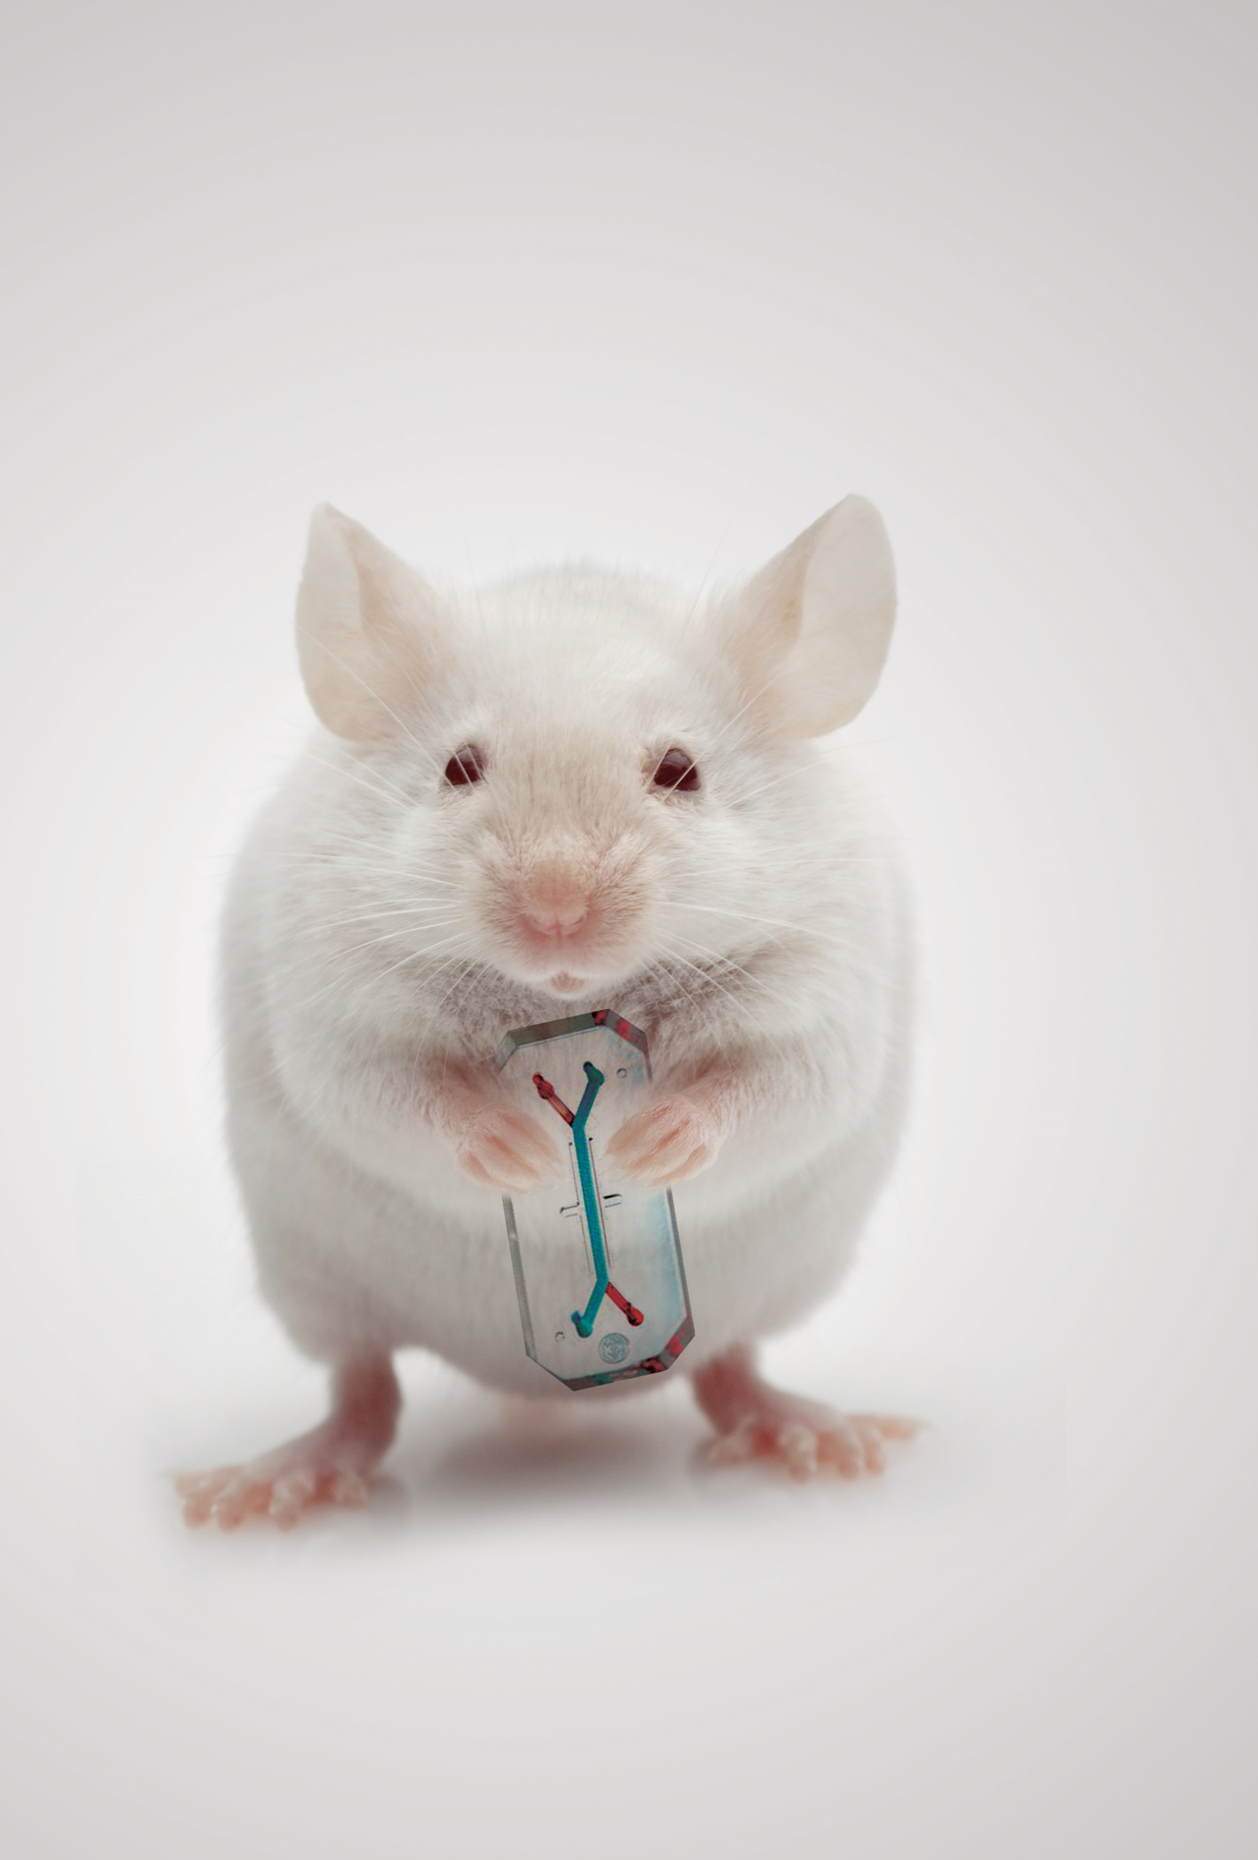
Organ-on-a-Chip
Scientists have created cell-based models for organs, including the lung, heart and liver.
Organ-on-a-chip models are 3D bioengineered devices made from cells designed to accurately mimic the function of tissues and organs.
Multiple chips can even be linked together to create multi-organ systems.
These chips have the potential to replace animals in many areas of research, from toxicity testing to the study of infection by viruses like COVID-19.

Slide 7
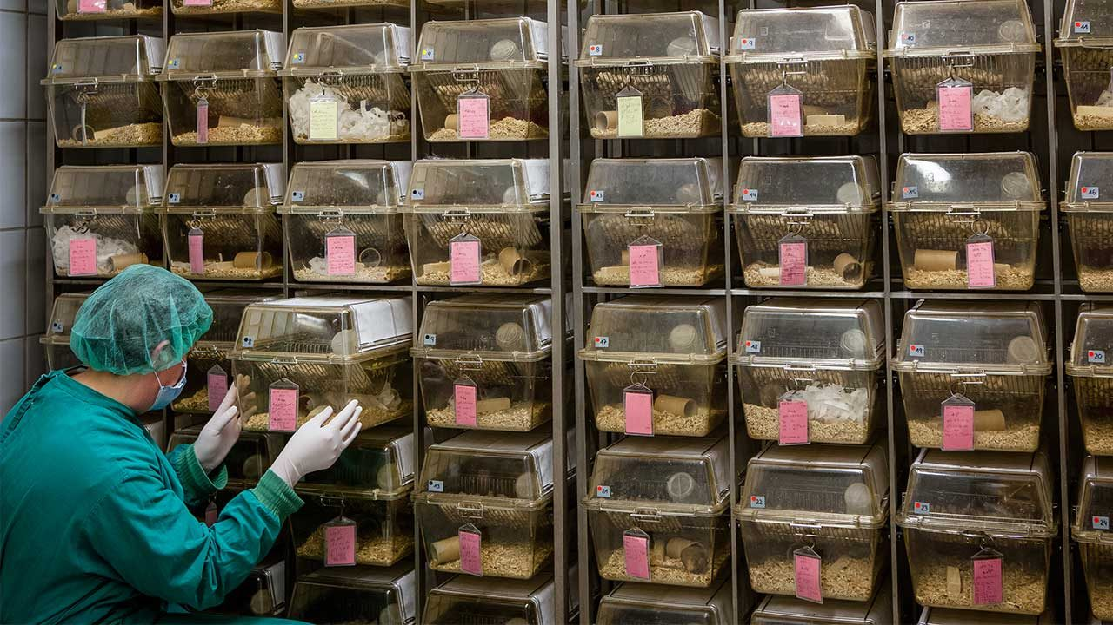
How many animals are needed?
Animal experiments need subjects, in both control groups and treatment groups.
The number of animals in each group must be sufficiently large to ensure the experiment yields accurate results.
How can scientists reduce the number of animals harmed by experimentation without compromising the integrity of their results?

Slide 8
Strategies for Reduction
  Conduct a statistical power analysis to determine the fewest number of animals needed to yield significant results.
  When possible, use the same animal for multiple experiments.
  When possible, use the same animal for the control and treatment group.
    Example: instead of observing one rabbit given an eye medicine and another given a saline control, observe a single rabbit with eye medicine in one eye and a saline control in the other.

Slide 9
Options for Refinement
Pain and distress felt by laboratory animals are not only harmful to animals but can also lead to variation in experimental results.
Refinement approaches can include improvements in how animals are housed and modifications in experiments performed on them.
Examples of refinement include:
  Using appropriate pain management medications to reduce pain
  Training animals to cooperate with procedures, like blood draws, to reduce their distress
  Adding enrichment to their cages

Slide 10
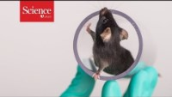
Enrichment Improves Research Results
https://www.youtube.com/watch?v=GB5BSzPsLsw

Slide 11

References
Hubrecht, R. C., & Carter, E. (2019). The 3Rs and Humane Experimental Technique: Implementing Change. Animals : an open access journal from MDPI, 9(10), 754.
Russell, W. M. S., & Burch, R. L. (1959) (as reprinted 1992). The Principles of Humane Experimental Technique. Wheathampstead (UK): Universities Federation for Animal Welfare.

